Slide 1

IEORE 4523 Data Analytics
The Influence of Neighborhood on Subway Travelling
Presented by Group Data Dynasty

Slide 2

Covered Today
A brief outline
Introduction
Data Cleaning and Processing
Machine Learning Models and Comparison
Conclusion and Future Improvements

Slide 3
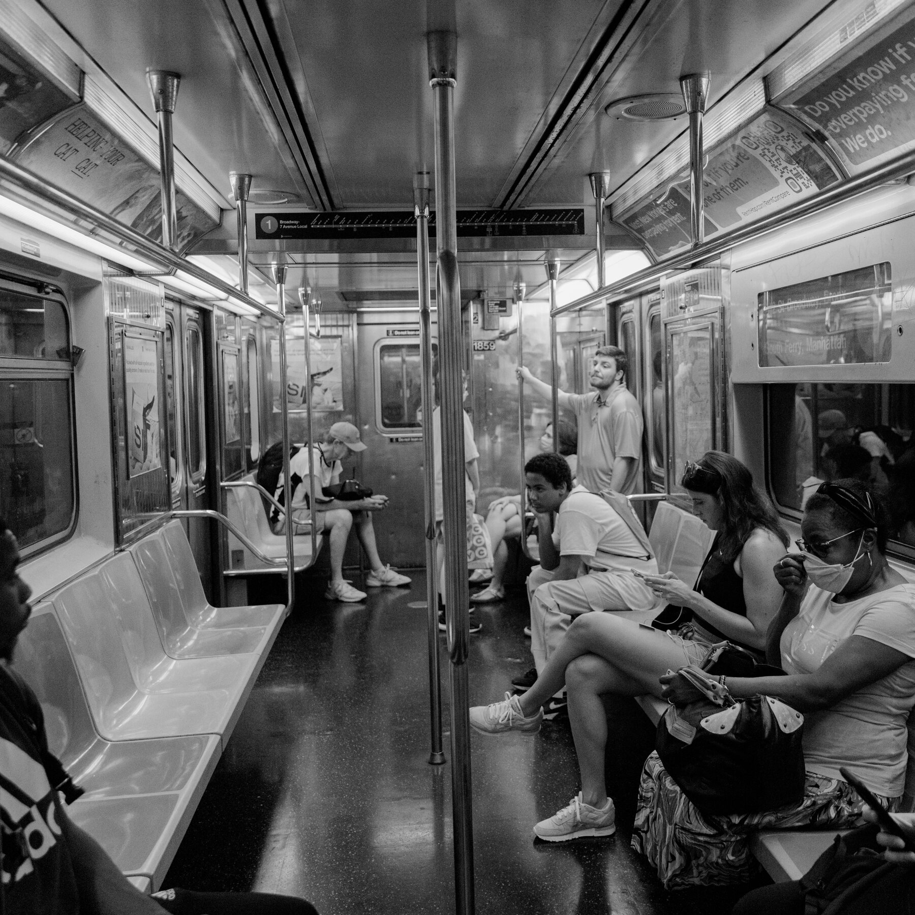
Introduction
Method: Integrate demographic factors associated with neighborhoods to conduct an analysis of subway traffic patterns
Goal:
Provide insights about the relationship between subway usage and the demographic characteristics of neighborhoods
Provide insights into the dynamics of subway usage in the post-pandemic era
Notes:
Utilize neighborhoods demographic features to analyze subway traffic patterns

Slide 4
Data Cleaning and Processing
Kaggle website
NYC_neighborhood_census_data_2020.csv
NYC_subway_traffic_2017-2021.csv
Notes:
We obtained two datasets from Kaggle: one focused on subway traffic and the other on the census data of New York City neighborhoods. The subway traffic data spans from February 4th, 2017, to August 13th, 2021, capturing entries and exits at 4-hour intervals across 469 stations. Comprising 4,589,380 entries and 17 columns, this dataset forms the backbone of our analysis. Additionally, we incorporate NYC neighborhood data, associating each station with one of 51 neighborhoods and augmenting our insights with 87 financial and demographic variables.

Slide 5
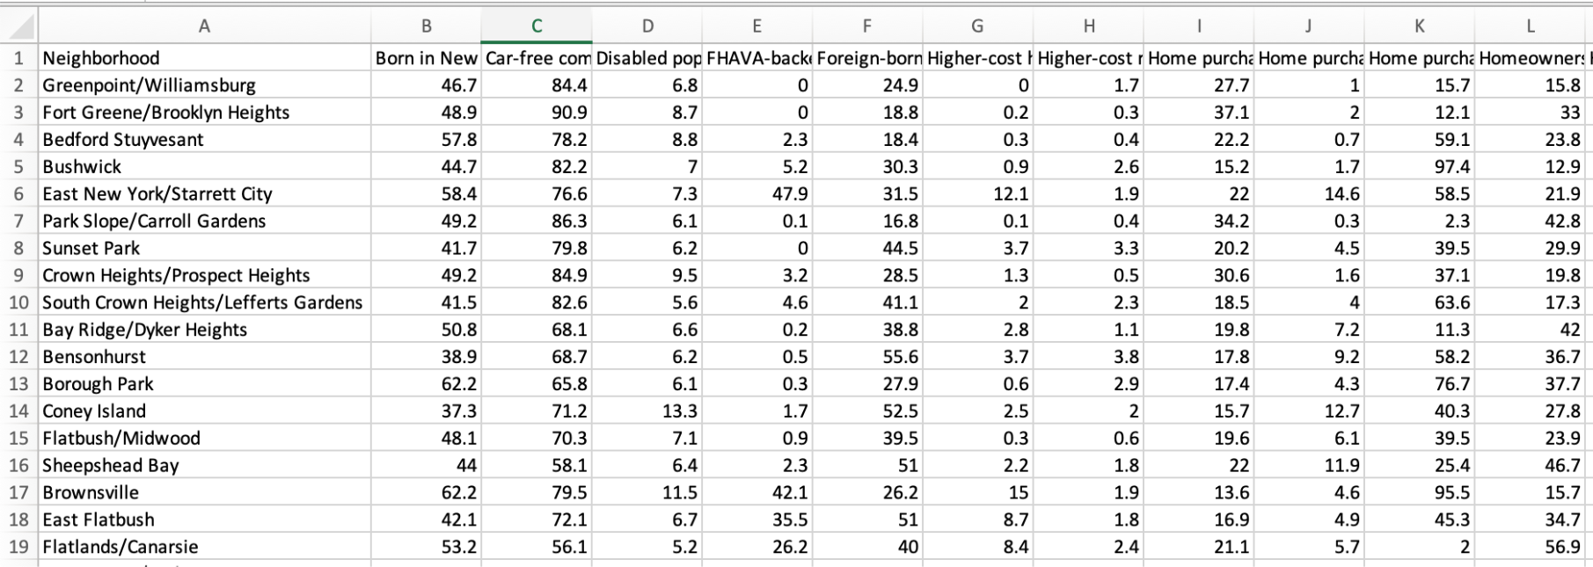
NYC_neighborhood_census_data_2020.csv
Notes:
unemployment rate
housing units
populaion

Slide 6
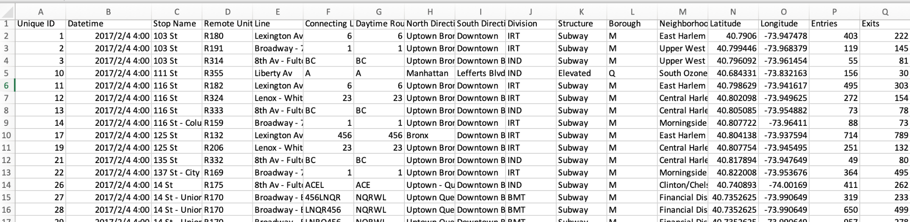
NYC_subway_traffic_2017-2021.csv
Notes:
it's worth noting that

Slide 7
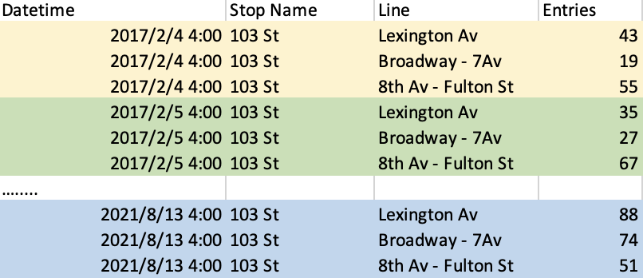
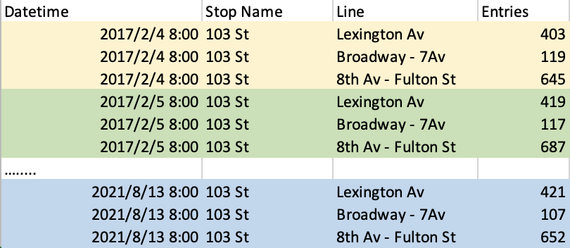
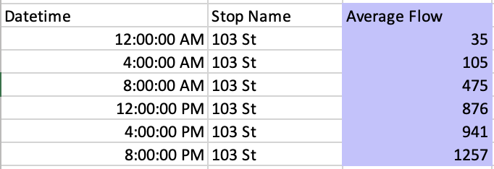
Dependent Variables
Average Flow: average passenger flow at a given subway station, different lines and different times throughout the day

Slide 8
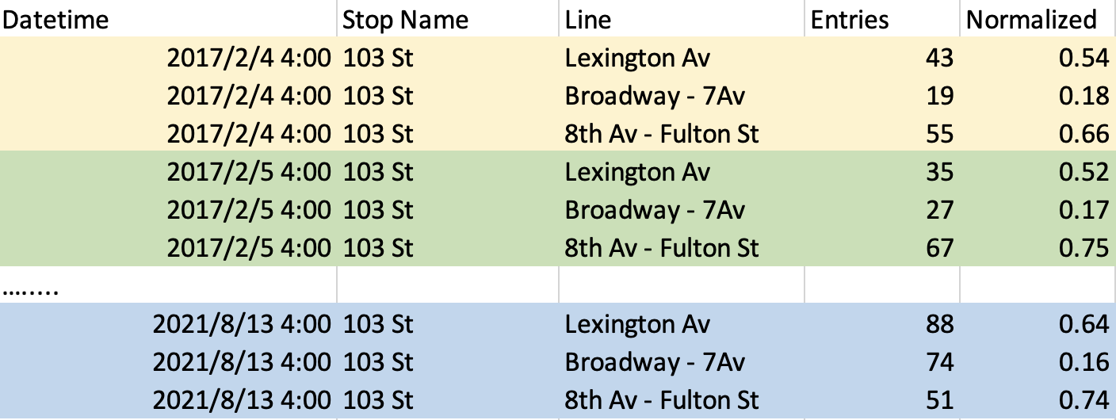
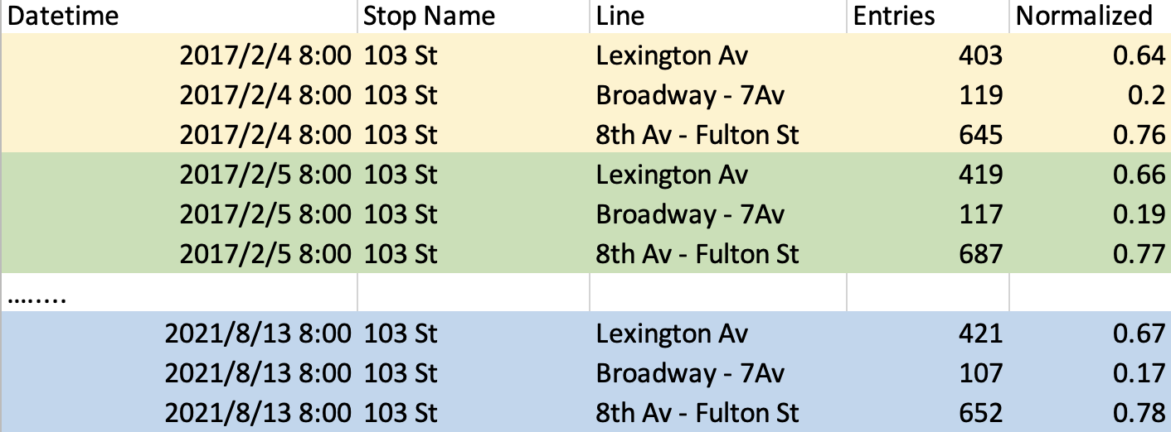
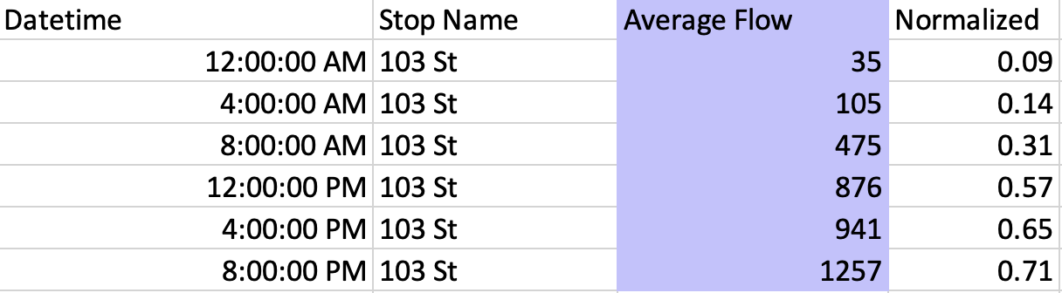
Dependent Variables
Normalized Flow: normalize each line’s entries flow by dividing by the average flow during the same time period

Slide 9
Independent Variables Selection
Random Forest
selected Importance index>=0.005
Avoid multicollinearity
delete high Correlation value & Variation Inflation Factor(VIF) between variables

Slide 10
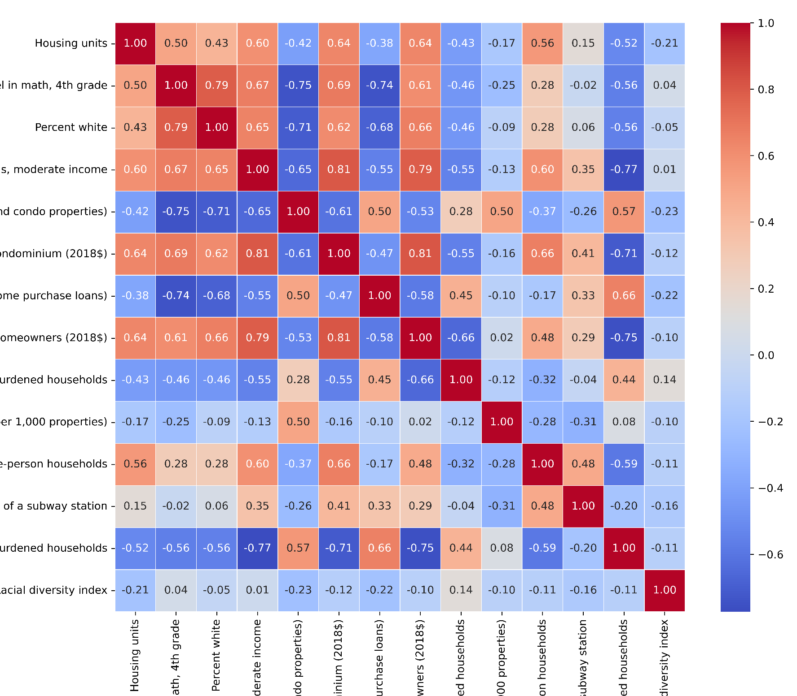
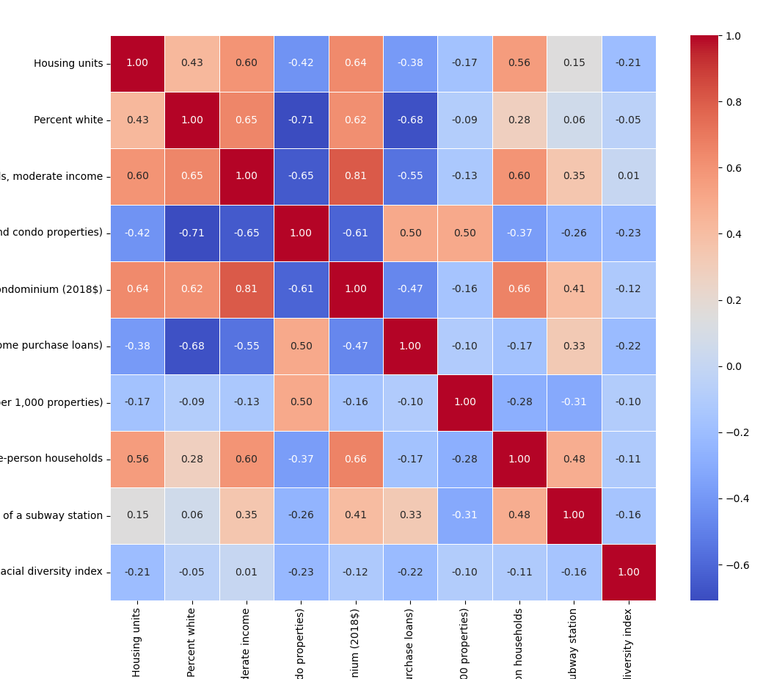
Independent Variables Selection

Slide 11
Independent Variables
Moderately rent-burdened households, moderate income
Pre-foreclosure notice rate
(per 1,000 condo properties)
Housing units
Percent white
Home purchase loans to LMI borrowers
Single-person households
Refinance loan rate (per 1,000 properties)
Racial diversity index
Median sales price per unit, condominium
Residential units within 12 miles of
a subway station

Slide 12

Machine Learning Models and Comparison
Linear Regression, Decision Tree, Random Forest
SVM, Neural Network, Time Series Model

Slide 13
The way we split the data…
80%
20%
Train Set
Test Set

Slide 14
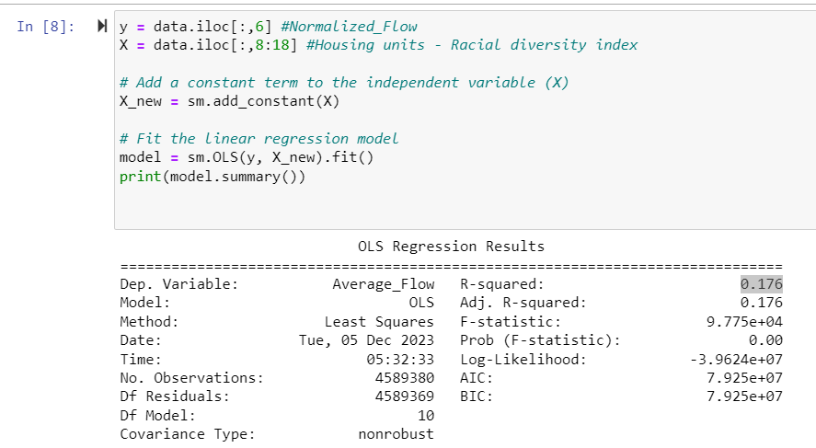
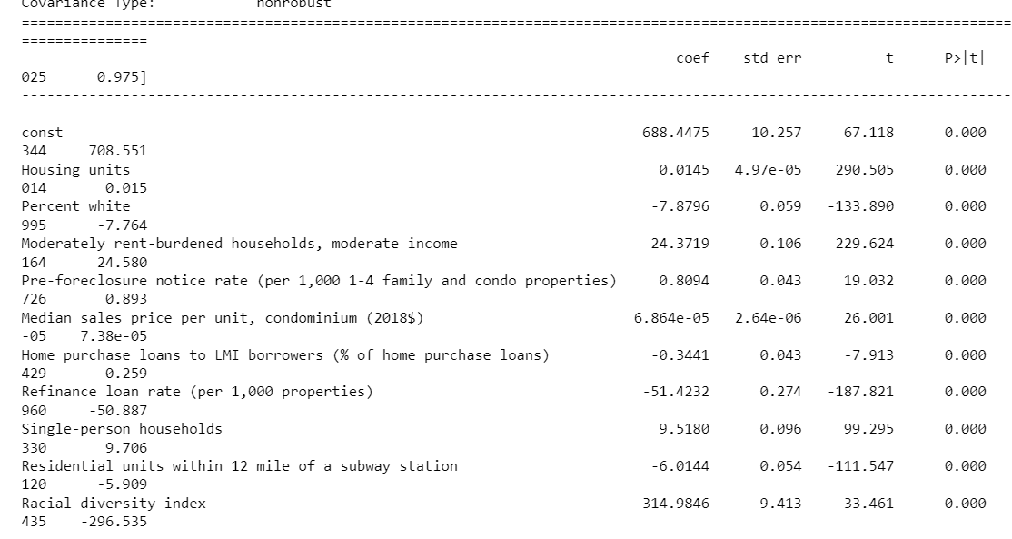
Linear Regression Model - Initial Fit
First applied Multiple Linear Regression to the dataset through OLS
This resulted in a low overall R-squared score of 17.6% despite all the feature variables appearing to be statistically significant (zero p-scores)
Strongly indicates that we are missing something important - that average flow changes every four hours but the features do not
There are only six average of average flow per year
Notes:
The first model that we used is linear regression. We initially applied Multiple Linear Regression using simple OLS with average flow as the dependent variable and ten selected features as the independent variables. Despite obtaining a low R-squared score of 17.6%, all feature variables had statistically significant p-values of zero. This is indicative of something important missing - that average flow changes every four hours but the features do not. In fact, there are only six values for the whole year for each station.

Slide 15
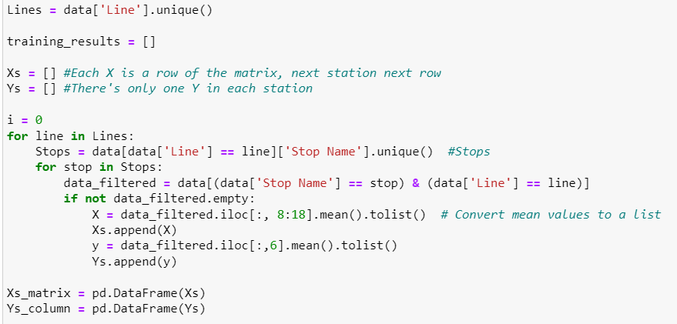
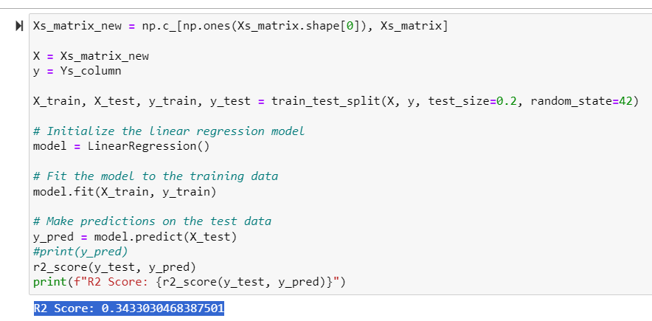
Linear Regression Model - Improvement
We reanalyzed by splitting the dataset into separate lines and stations
We made the mean value average flow across four years for each station the new dependent variable, which should be identical to the mean of the six values of average flow per day
We test if the mean average flow (of 6 values) of each station can predicted by the station specific independent variables
We look at the data of all 500 stations, use 80% as training data. And we found that the model was improved as the r-squared score of test set was 35%.

Slide 16



Random Forest Model
Tree
Max_depth
Normalization
The number of trees in a Random Forest is a crucial parameter influencing model performance.
It influences the trade-off between overfitting and underfitting, computational efficiency, and interpretability.
In order to bring all features to a similar scale or range.
Notes:
I will present the following machine learning models: the first one is RF model, where we focus on two parameters: the number of trees and the max depth. Both of the parameters will influence the fitting ability of our models. And before that I have done normalization over data.

Slide 17
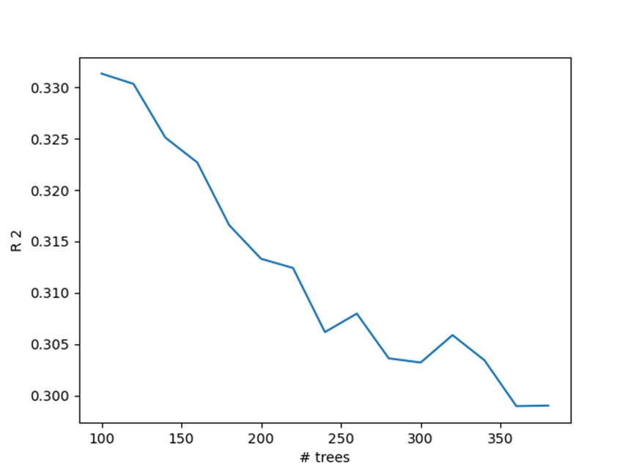
Random Forest Model
—the influence of # of trees
From 100 to 400, we select different number of trees as our parameter
The model of 100 trees performs best with accuracy > 0.330
Overall, more trees, lower accuracy, which may be caused by overfitting.
Notes:
This is the graph based on the number of trees, and we can find…

Slide 18
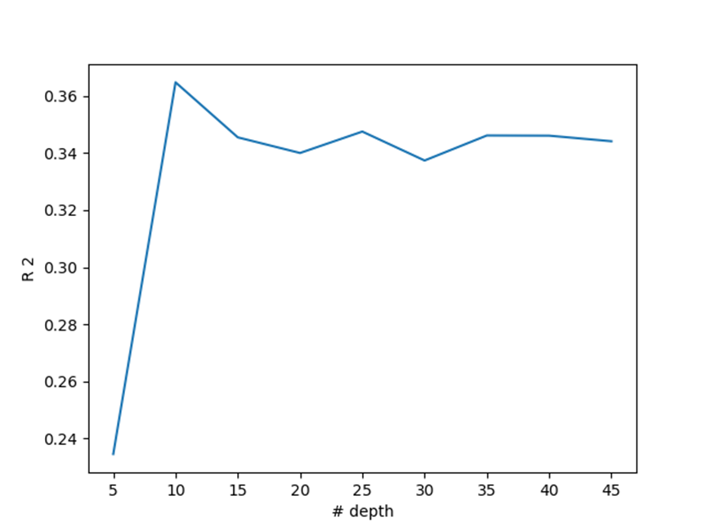
Random Forest Model
—the influence of max depth
From 5 to 45, we select different depth as our parameter
The model with max_depth around 10 performs best with accuracy > 0.360
There is no obvious difference when max_depth > 10
This implies there’s non-linear relationship in our data
Notes:
…. And there we also obtained the importance of each variables from RF

Slide 19
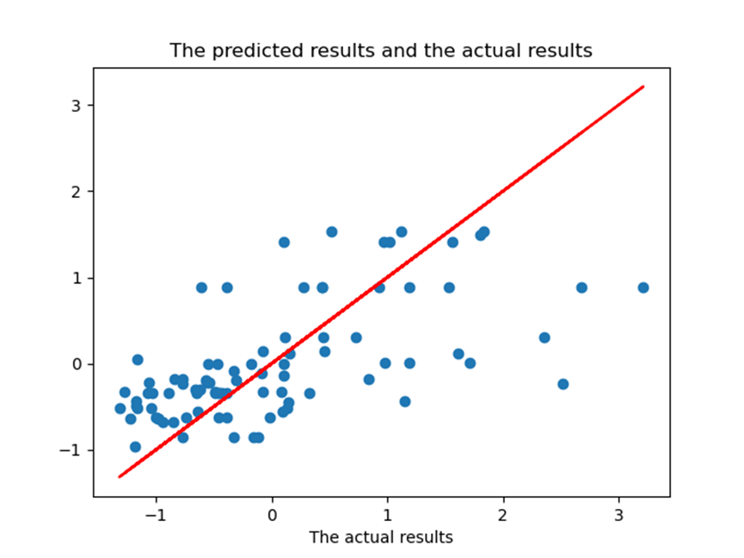
activation = "tanh"
Neural Network
solver = 'lbfgs'
Adjustment to parameters
alpha = 1e-5
hidden_layer_sizes = (180, 50)
R^2 between 0.38 - 0.40
Notes:
The second one is

Slide 20
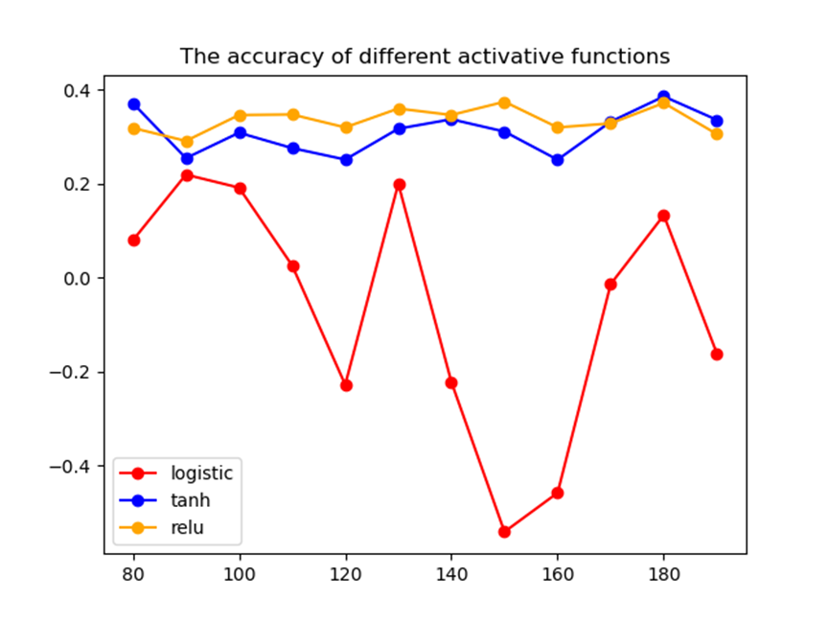
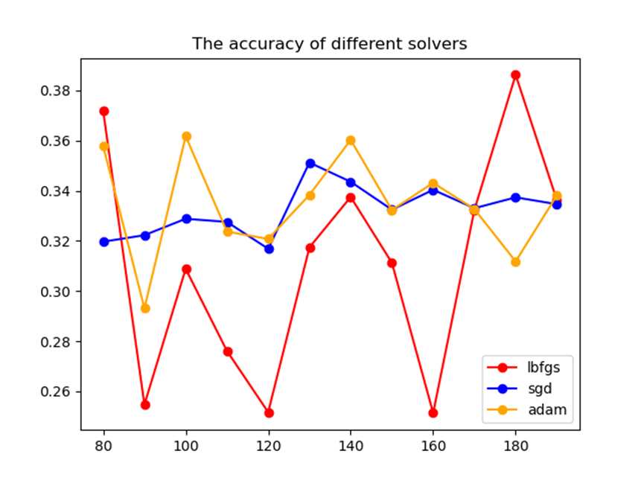
Different Activation Functions
Both of Relu and Tanh activation functions have relevant high accuracy, which means this kind of activation mechanisms may be more useful than Logistic.
Different Solvers
Given all the other parameters default, the difference of accuracy between Lbfgs, Sgd, Adam is shown：
Notes:
There’s the comparison for different functions

Slide 21
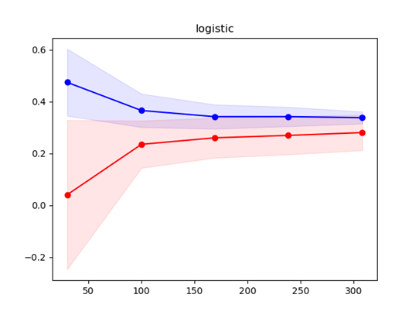
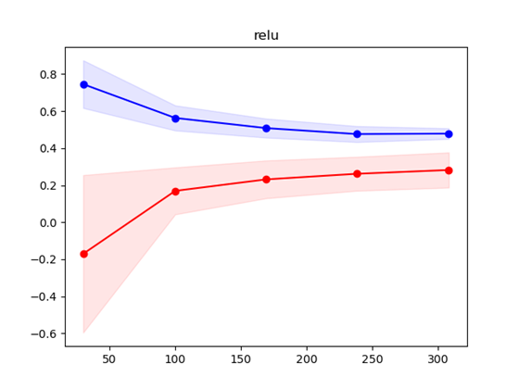
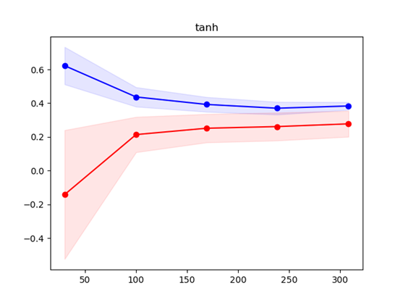
Results
Logistic and Tanh have relevant better fitting ability, while Relu is quite underfitting.
It may be caused by a gradient vanishing problem in negative value regions
The learning curve

Slide 22
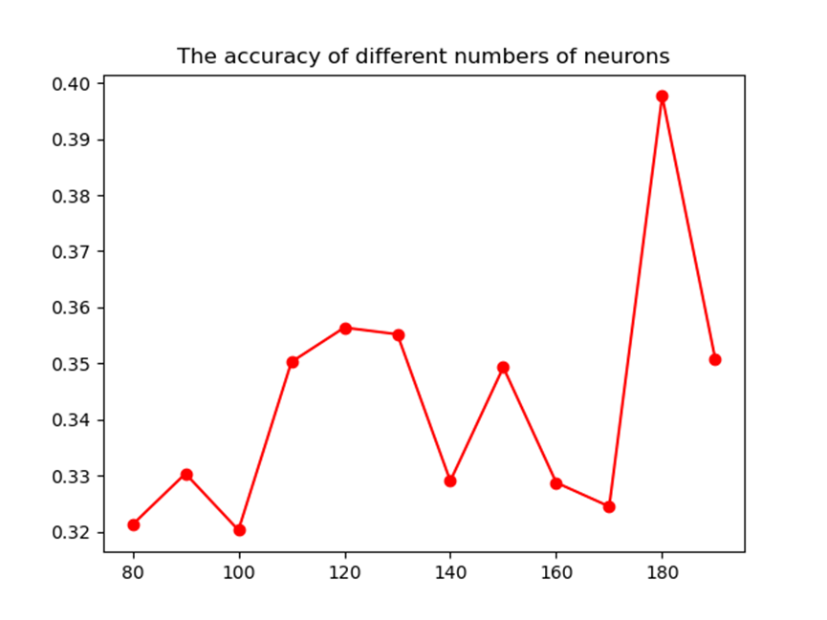
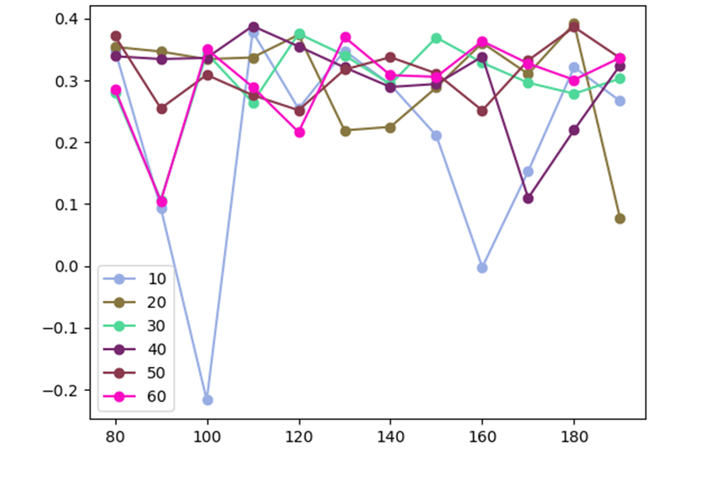
The Number of neurons
two hidden layers
one hidden layer
Adjusting the number in the second layer

Slide 23
Decision Tree Model
Datasets：
Identified different subway lines and conducted individual analyses for each stop along each line. The average flow statistics for each line were collected to serve as the target variable for model prediction.
Parameters：
Maximum Depth (max_depth): The depth of the model is set to 3 to promote model simplicity and prevent overfitting.
Fit Criterion: Mean Squared Error and R² are used as metrics to measure performance.
Training process：
The data set was split into 80% for the training set and 20% for the testing set.

Slide 24
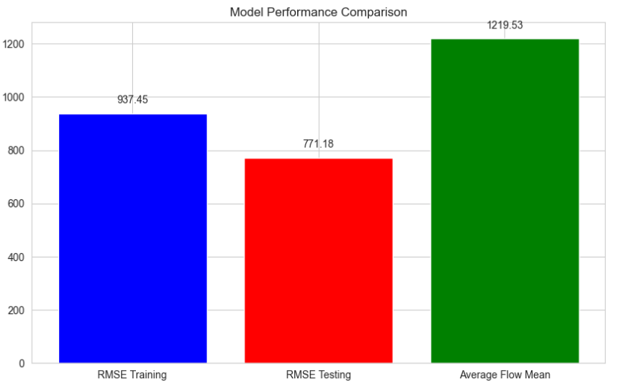
Decision Tree Model
RMSE results：
The model's RMSE on the training set is 771.18, while it increases to 937.45 on the test set. This difference indicates that the model performs worse on unseen data compared to the data used during training. The bar chart shows that the RMSE values are lower than the average flow mean, suggesting that the model has a certain advantage over a baseline model (which predicts using the mean).
R-square results：
Training R square: 0.398 Testing R square:0.229
The low R² on both the training (0.398) and testing (0.229) datasets suggests that the decision tree model struggles to capture the essential factors influencing subway flow, particularly the linear relationships and time dependencies.There is a strong linear relationship between average flow and variables such as 'Housing units' and nearby 'Residential units', but decision tree models are not adept at handling linear relationships within data. Additionally, average flow data is significantly influenced by temporal factors, which decision tree models do not capture effectively.

Slide 25
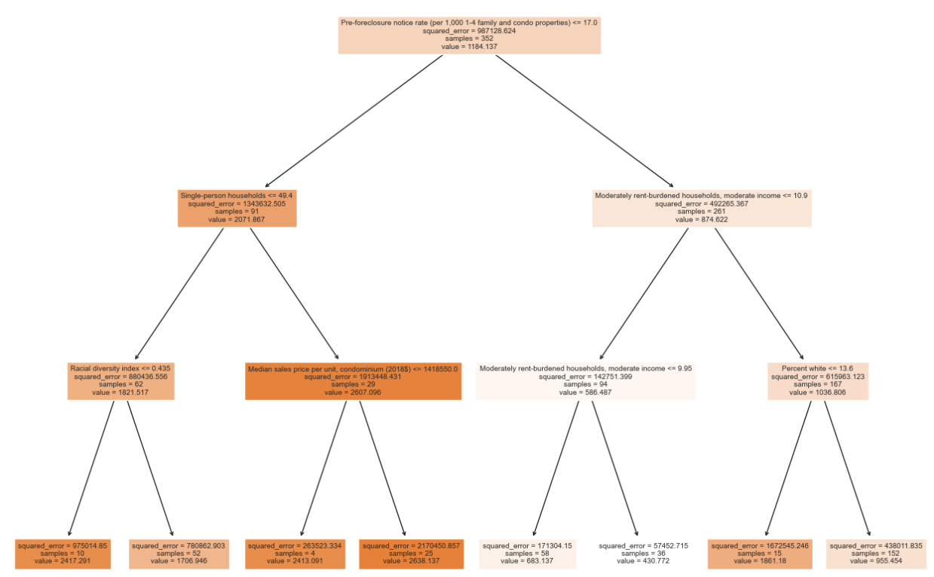
Decision Tree Model
Key Predictive Factors: The decision tree's initial split on "single-person households" indicates its significance in predicting subway flow, possibly due to single residents' higher likelihood of using the subway.
Economic Indicators: Splits related to "moderately rent-burdened households" and "median condo sales price" suggest a relationship between economic status and subway usage, with potentially higher usage in economically burdened areas.
Demographics and Housing: Features like "racial diversity index" and "housing unit numbers" hint at their influence on subway flow, with diverse areas potentially showing varied transit needs.

Slide 26
Model Comparison
 | Linear Regression | Random Forest | Neural Network | Decision Tree
R Square | 0.343 | 0.339 | 0.386 | 0.229

Slide 27
Time Series Model - Preparation
Each station has its own time series of subway flow
Would be better to look at the time series for each station separately instead of the entire dataset as a whole
The two stations we are analyzing:
1st Avenue Station of the Canarsie line
Broad Street Station of Jamaica Line
We simplified the data to be daily instead of hourly
Notes:
Each station's subway flow forms individual time series of their own in the dataset. So we found that instead of performing time series analysis on the entire dataset collectively, it's more practical to examine the individual stations’ time series separately. Two specific stations, 1st Avenue Station (Canarsie Line) and Broad Street Station (Jamaica Line), were selected for analysis. Besides, the data was transformed from hourly to daily.

Slide 28
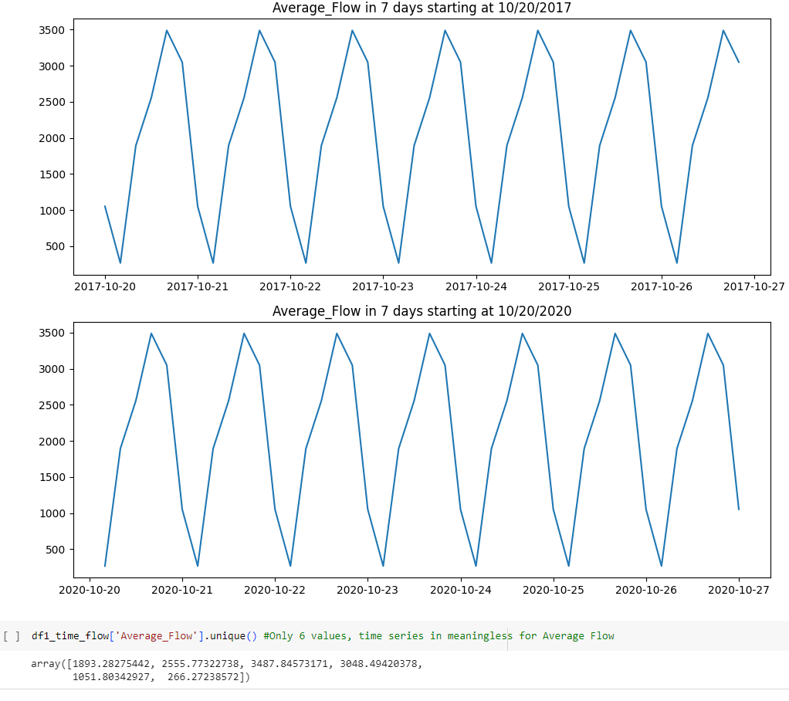
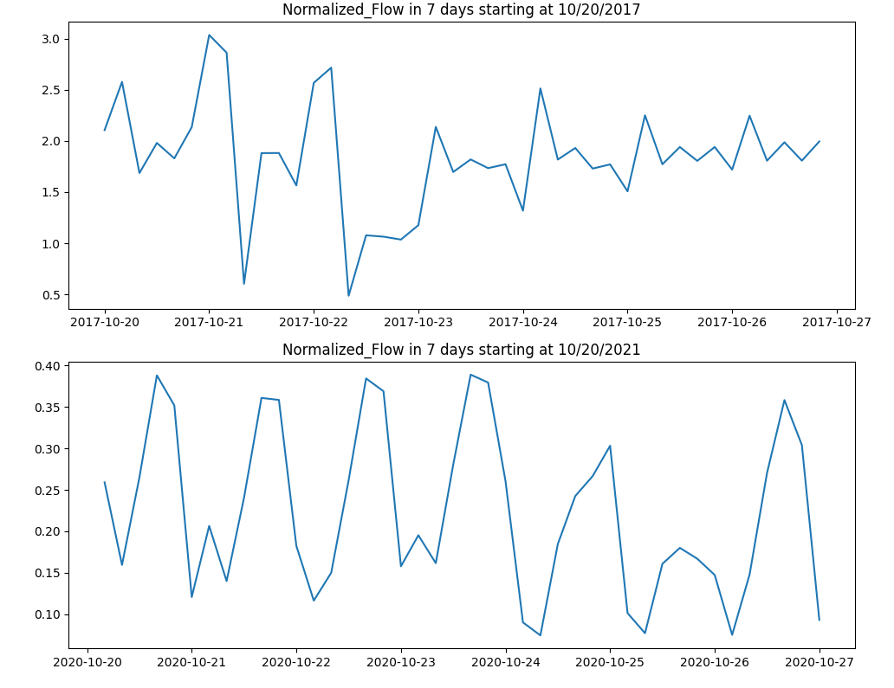
Time Series Model - New Dependent Variable
Time Series Regression on Average Subway Flow will not work - Make Normalized Flow our new dependent variable for this model
Average Flow is identical every day between 2017 and 2021
It would be meaningless to perform time series regression models on Average Flow
Normalized flow would make a better dependent variable for our time series model instead

Slide 29
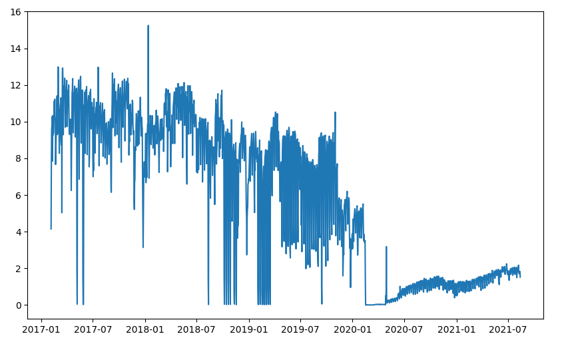
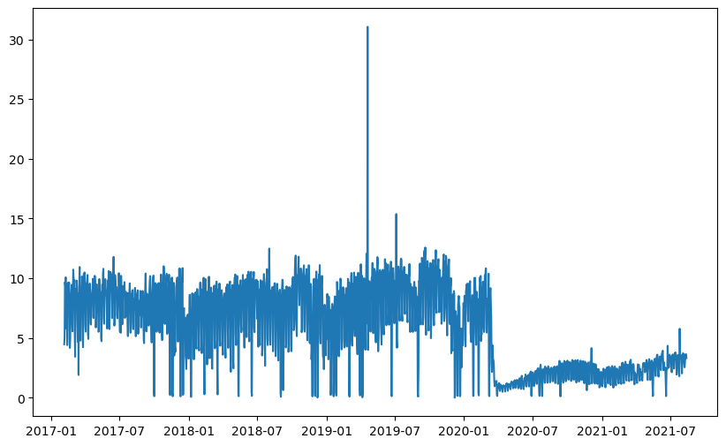
Time Series Model - COVID impacts on Subway in 2020
COVID
COVID
Aggregate time series for Broadway Station (Jamaica Line)
Aggregate time series for 1st Avenue Station (Canarsie Line)
Each time series should be split into two with COVID as the cutoff
Notes:
Attempts to create a time series of Average Flow revealed consistent values daily from 2017 to 2021, making predictions meaningless. Therefore, we chose Normalized flow as a more suitable dependent variable for the time series model. If you look at the diagrams, you can see the differences between average flow on top and normalized flow at the bottom for 1st Avene station.

Slide 30
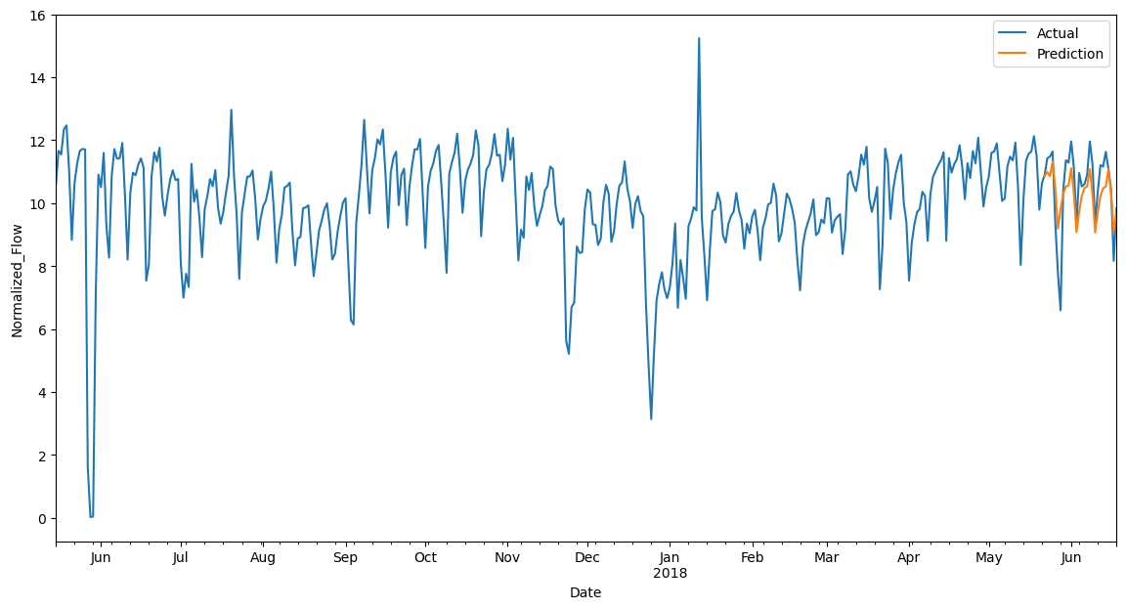
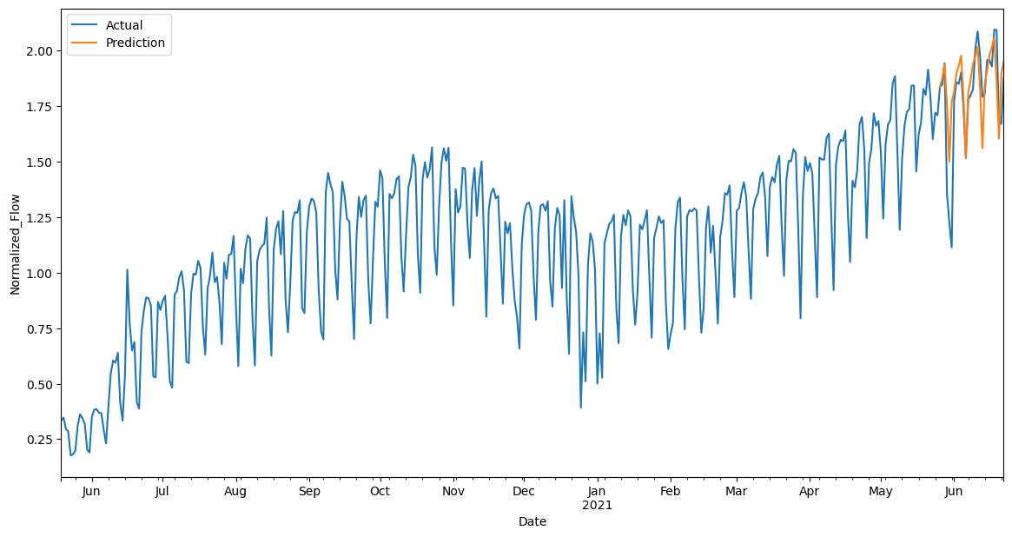
Time Series Model - ARIMA Fitted, 1st Avenue Station
1st Avenue Station (Canarsie line) pre-COVID
1st Avenue Station (Canarsie line) post-COVID
Model: SARIMAX(1, 0, 3)x(1, 0, [1], 7)
Model: SARIMAX(1, 1, 1) x (2, 0, 1, 7)
Trend

Slide 31
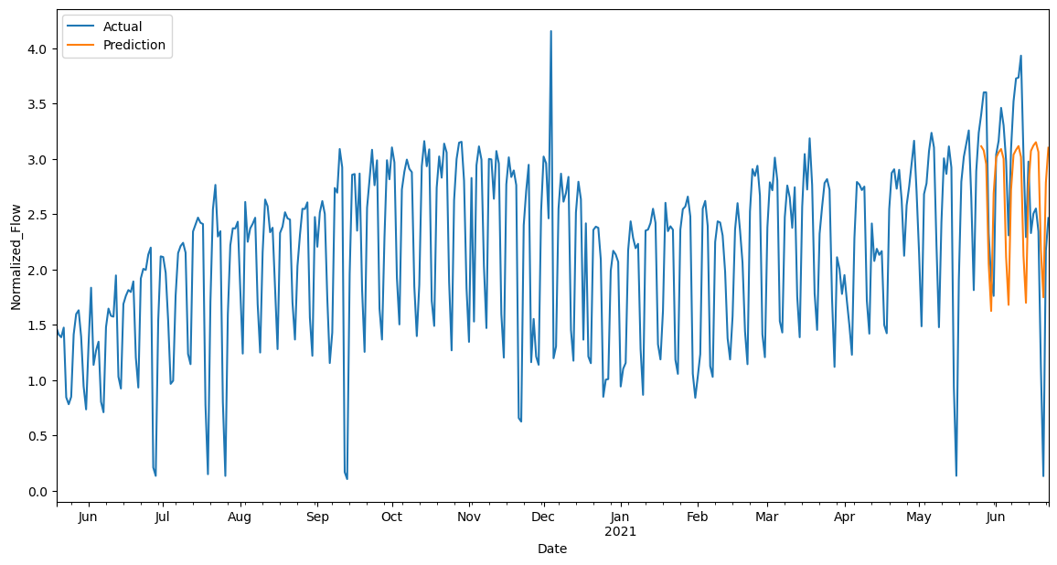
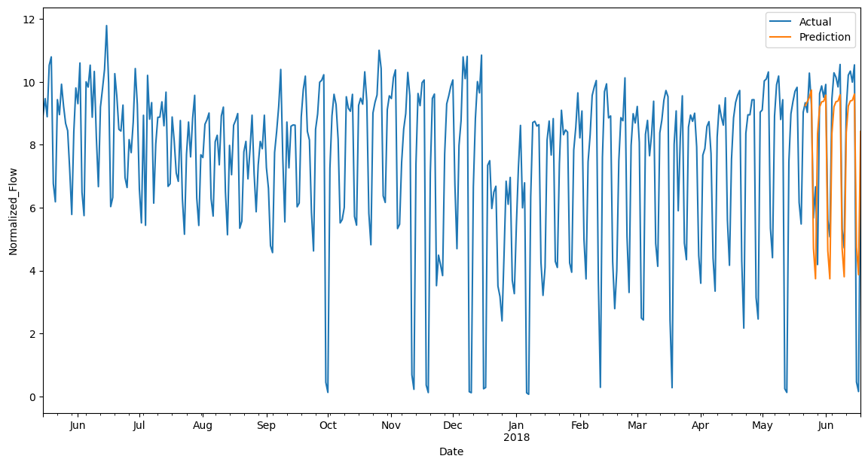
Time Series Model - ARIMA Fitted, Broadway Station
Broadway Station (Jamaica Line) post-COVID
Broadway Station (Jamaica Line) pre-COVID
Model: SARIMAX(5, 1, 1) x (2, 0, 1, 7)
SARIMAX(3, 1, 1) x (2, 0, [1, 2], 7)

Slide 32
Conclusion
Further Explorations
Whether the recovery rate of subway travel after pandemic is also related to neighborhood features?

Slide 33
Be Inspired
Thank you
Group Data Dynasty

